Slide 1
Evolutionary Computation
(Swarm Intelligence)
Lecture Module 24

Slide 2

Swarm Intelligence (SI)
Swarm describes a behaviour of an aggregate of animals of similar size and body orientation.
Swarm intelligence is based on the collective behavior of a group of animals.
Collective intelligence emerges via grouping and communication, resulting in successful foraging (the act of searching for food and provisions) for individual in the group.
Examples : Bees, ants, termites, fishes, birds etc
  Marching of ants in an army
  Birds flocking in high skies
  Fish school in deep waters
  Foraging activity of micro-organisms

Slide 3
Contd…
In the context of AI, SI systems are
  based on collective behavior of decentralized, self-organized systems.
  typically made up of a population of simple agents interacting with one another locally and with their environment causing coherent functional global pattern to emerge.
  distributed problem solving model without centralized control.
Even with no centralized control structure dictating how individual agents should behave, local interactions between agents lead to the emergence of complex global behavior.
Swarms are powerful which can achieve things which no single individual could do.

Slide 4
Advantages
Adaptability
  Self-organizing
Robustness
  Ability to find a new solution if the current solution becomes invalid
Reliability
  Agents can be added or removed without disturbing behaviour of the total system because of the distributed nature
Simplicity
No central control

Slide 5
Swarm inspired methods
ANT COLONY OPTIMIZATION (ACO)‏
  Invented by Marco Dorigo in 1991.
  Inspired by behaviour of ants.
  Real ants lay down pheromones directing other ants to resources while exploring their environment.
  Used extensively for discrete optimization problems.
PARTICLE SWARM OPTIMIZATION (PSO)‏
  Population based stochastic optimization technique developed by Eberhart and Kennedy in 1995.
  Inspired by social behaviour of flocks of birds and school of fish

Slide 6
Ant Intelligent Systems
A set of agents (similar to ants), search in parallel for good solutions and co-operate through the pheromone-mediated indirect method of communication.
They belong to a class of meta-heuristics.
These systems started with their use in the Traveling Salesman Problem (TSP).
They have applications to practical problems faced in business and industrial environments.
The evolution of computational paradigm for an ant colony intelligent system (ACIS) is being used as an intelligent tool
  to help researchers solve many problems in areas of science and technology.

Slide 7
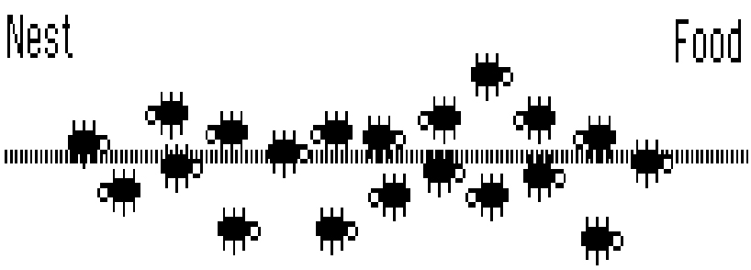
Ant Colony Systems
Biological Ant Colony Systems
  Organizing highways to and from their foraging sites by leaving pheromone trails.
  Form chains from their own bodies to create a bridge to pull and hold food together.
  Division of labour between major and minor ants.

Slide 8
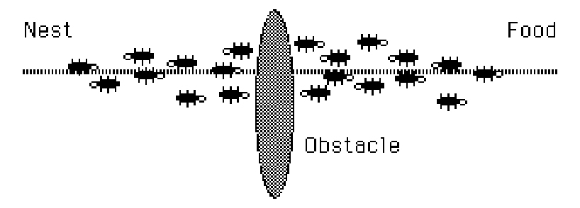
Interrupt The Flow

Slide 9
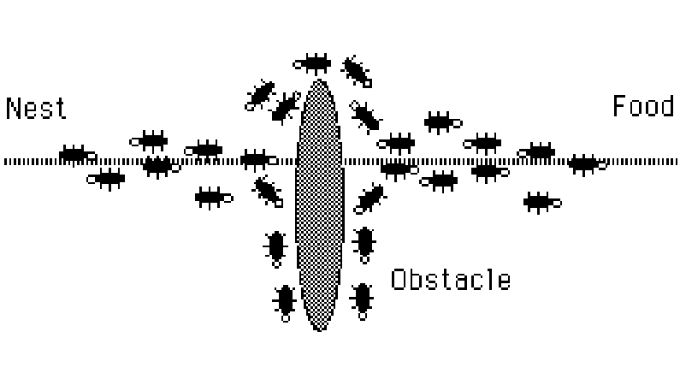
The Path Thickens

Slide 10
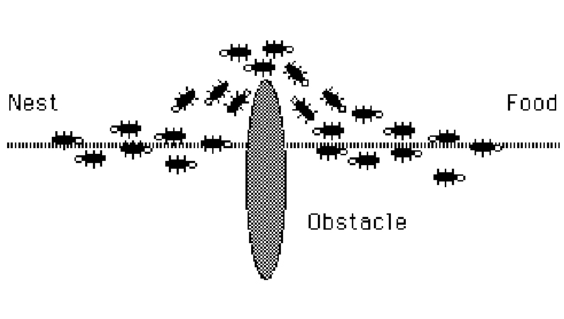
The New Shortest Path

Slide 11
Contd…
How do real ants find the shortest path?
  Ants can smell pheromones, they tend to choose the paths marked by strong pheromone concentrations.
  The emergence of shortest paths can be explained by
    Autocatalysis : positive feedback
    Differential path length
  Communication is indirect through pheromones.
  Ants indirectly influence other ants to follow the path (Recruitment)‏

Slide 12
Simulated Ant Colony System (AACS)‏
Similarities
  A colony of cooperating individuals
  An artificial pheromone trail for communication
  A sequence of local moves for finding the shortest paths
  A stochastic decision policy using local information and no look ahead
Differences‏
  Ant moves are discrete,
  Ants have an internal state having memory of past actions
  Ants can deposit a particular amount of pheromone at certain time instances which may not reflect real behaviour
  Enrichment with other techniques like backtracking, etc

Slide 13
Probabilistic Decision Rule
Working involves two procedures
    Specifying how ants construct or modify a solution for the problem in hand.
        Done in a probabilistic way based on problem dependent heuristics and amount of pheromone previously deposited in this trail.
    Updating the pheromone trail.
Let k^{th} ant (denoted by ant_{k}) is located at the i^{th} node and pt_{ij} is intensity of pheromone trail on the Arc(i, j).
The probability of moving ant_{k} located in i^{th} node to j^{th} node is defined as follows:
prob_{ij}(k) = pt_{ij} / ∑ pt_{im} , ∀ m ∈ Neighour set of i

Slide 14
Pheromone Updation Rule
In simple ACO algorithm, constant amount of pheromone Δ is deposited by ants.
The pheromone updation at time ‘t’ from i^{th} node to j^{th} node is defined as follows
  pt_{ij} (t) = pt_{ij}(t) + Δ
This increases the probability of the arc that can be used by other ants in future.
Alternatively at the end of each cycle (or route), the intensity of pheromone trails on each arc is updated by the following pheromone updating rule
pt_{ij} =ρ pt_{ij} + ∑Δpt_{ij}(k), k = 1 to m
  where ρ ∈ (0,1) is the persistence rate of previous trails, Δpt_{ij}(k) is the amount of pheromone laid on Arc(i, j) by the ant_{k} at the current cycle, and m is the number of distributed ants.

Slide 15
Exploration (Evaporation) Mechanism
To avoid quick convergence of all the ants towards sub optimal path, an exploration mechanism is added.
It is similar to pheromone trail evaporation in real scenario.
It is carried out by decreasing pheromone trail in each iteration of algorithm using the following factor.
  Δ = (1 - γ )*Δ , γ ∈ (0, 1)
This decrease can be done in various ways, such as:
  While moving from i^{th} node to j^{th} node, ant can update pheromone trail pt_{ij} on the Arc(i, j).
  Once the solution is built, the ant can retrace the same path and update pheromone trail of the each arc on the path.
  Pheromone trail can be updated offline using global information.

Slide 16
Applications
Traveling Salesman Problem
Quadratic assignment
Job shop scheduling
Vehicle routing
Sequential ordering
Graph colouring
Network routing
Flow manufacturing
Layout of facilities
Space planning
Numeric optimization

Slide 17
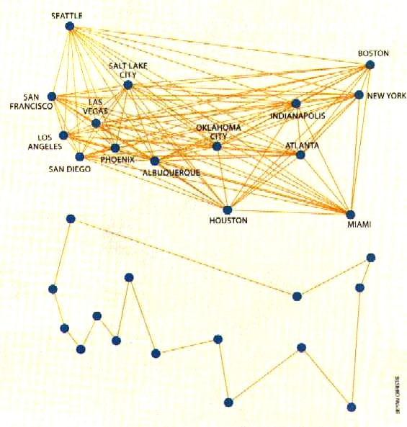
Ant Colony Systems - TSP
Traveling Salesman Problem
  Hard combinatorial problem
  Because of suitability and flexibility, ant intelligence is used.
  Assume that there are ‘n’ cities.
  Let ‘m’ be total number of ants used for solving the problem.

Slide 18
Algorithmic Steps
Distribute ‘m’ ants randomly / uniformly amongst different cities at time t = 0.
Initialize pt_{ij}(0) = C, a small positive constant.
SetTabu list of each ant with its starting (assigned) state.
Repeat
  Iterate the following ‘n’ times for one cycle.
    Move each ant at time t+1 from the current state to next state according to probabilistic rule.
    Update the Tabu list for this particular cycle.
  Once the cycle is complete, save the minimum distance covered among all the tour distances by all ants for that particular cycle.
  After each complete tour, update the pheromone trail.
Until there is no improvement in the shortest tour saved.
Display the shortest path

Slide 19
Particle Swarm Intelligent Systems
Originated with the idea to simulate the unpredictable choreography of a bird flock with
  Nearest-neighbour velocity matching
  Multi-dimensional search
  Acceleration by distance
  Elimination of ancillary variables
Advantages
  Simple
  Few parameters
  Easy to implement
  Robust
  Searches a much larger portion of the problem space

Slide 20
Particle Swarm Optimization (PSO)
PSO shares many similarities with Genetic Algorithms (GA).
The system is initialized with a population of random solutions (called particles) and searches for optima by updating generations.
Each particle is assigned a randomized velocity.
Particles fly around in a multidimensional search space or problem space by following the current optimum particles.
However, unlike GA, PSO has no evolution operators such as crossover and mutation.
Compared to GA, the advantages of PSO are that it is easy to implement and there are few parameters to adjust.

Slide 21
Contd..
Each particle adjusts its position according to
  its own experience,
  the experience of a neighboring particle
Particle keeps track of its co-ordinates in the problem space which are associated with the best solution/ fitness achieved so far along with the fitness value (pbest← partcle best).
Overall best value obtained so far is also tracked by the global version of the particle optimizer along with its location (gbest).
Two versions (according to acceleration)‏
  Global
    At each time step, the particle changes its velocity (accelerates) and moves towards its pbest and gbest.
  Local
    In addition to pbest, each particle also keeps track of the best solution (lbest/nbest – neighbour best) attained within a local topological neighbourhood of the particle.
    The acceleration thus depends on pbest, lbest, and gbest.

Slide 22
Cont…
The particle position and velocity update equations in the simplest form that govern the PSO are given by

Slide 23
PSO Algorithm
Let f be a fitness function that takes a particle (solution) with several components in higher dimensional space and maps it to a single dimension metric as f :R^{m} → R.
Assume that there are n particles, each with associated positions xi ∈ R^{m} and velocities vi ∈ R^{m} , i = 1,…, n.
  Let Xi be the current best position of each particle,
  NXi be the current best position of its neighbours, and
  G be the global best.

Slide 24
Contd.. Algorthm :PSO
initialize xi and vi ∀i.;
Do the following assignments:
Xi ← xi, NXi ← Best of Neighbours(xi) and G ← best fitness value (f(xi)) ∀I;
repeat
{ for each particle
    create random vectors R1, R2, and R3 containing components having a uniform random number between 0 and 1;
    update the particle positions xi as xi ← xi + vi;
    update the particle velocities as
      vi ← ωvi + c1R1 ° (Xi – xi) + c2R2 ° (NXi – xi) + c3R3 ° (G – xi),
      where, ω is an inertial constant and usually good values are slightly less than 1; c1, c2 and c3 are constants indicating how much the particle is directed towards good positions; operator ° indicates vector multiplication;

Slide 25
Contd..
update the local bests
Xi ← xi, if f(xi) < f(Xi);
update the neighbour’s best
NXi ← Best of Neighbours(xi);
update the global best
G ← xi, if f(xi) < f(G);
} until convergence occurs;
report G to be the optimal solution;
Stop

Slide 26
Applications
PSO has been successfully applied in many areas: function optimization, artificial neural network training, fuzzy system control, and other areas where GA can be applied.
Important applications
  Ingredient mix optimization
  Reactive power and voltage control
  Evolving neural networks
  Optimization problems
  Classification
  Pattern recognition
  Biological system modeling
  Scheduling
  Signal processing
  Robotic applications
  Decision making

Slide 27
TSP: An example
Consider a normal solution sequence of TSP with n nodes S =(a_{i}), i=l ... n.
The Swap Operator SO(i₁, i₂) is defined as exchanging the node at i₁ and i₂ position in solution S.
Then the new solution S' is defined as
S'=S+ SO(i₁, i₂),
The plus sign " + ' above has its new meaning.
For example: TSP problem with five nodes:
  Here is a solution:
S=(l, 3, 5, 2, 4).
  The Swap Operator is SO(1,2), then,
S'= S + SO(1, 2)= (1, 3, 5, 2, 4) + (1, 2) = (3, 1, 5, 2, 4).

Slide 28
Contd…
A Swap Sequence SS is made up of one or more Swap Operators.
  SS=(SO1, SO2, SO3, ..., SOn)
SO1, SO2, SO3, ..., SOn are Swap Operators, and the order of the Swap Operators in SS is important.
Swap Sequence acting on a solution implies all the Swap Operators of the Swap Sequence act on the solution in order.
This can be described by the following formula:
  S'= S + SS = S + (SO1, SO2, SO3, ..., SOn) = ((S+ SO1)+ SO2)+ ... + SOn

Slide 29
Applications: Clusters of entrepreneurs
Agents are entrepreneurs and the cities are the resources (productive inputs and market information) distributed in the business environment.
The ultimate goal is to find the shortest circular route between all resources.
Results
  The initial journey indicates how unproductive an entirely random search would be (entrepreneurs with no knowledge of their business environment and no precedents to follow are ineffective).
  Illustrates how the local self-organizing behaviour of individual entrepreneurs can result in the emergence of a pattern of entrepreneurial activity.
  Also, the addition of more virtual entrepreneurs at first increases the efficiency of the search. However, very large numbers of entrepreneurs in the same environment do not.

Slide 30
Routing in Telecommunication Networks
Researchers from Hewlett-Packard’s laboratories in Bristol, England, have developed a computer program based on ant-foraging principles that routes such calls efficiently.
Software agents roam through the telecom network and leave bits of information (digital pheromone) to reinforce paths through uncontested areas.
Phone calls then follow the trails left by the ant-like agents.
Digital pheromone continually evaporates, enabling the program to adjust quickly to changes in traffic conditions.
Ultimate application might be on the Internet, where traffic is painfully unpredictable: research results show improvements in both maximizing throughput and minimizing delays.

